Slide 1
Don’t let student evaluations cramp your style
Diane Gayeski, Ph.D.
Professor of Strategic Communication and former Dean
Roy H. Park School of Communications
Ithaca College. Ithaca, NY
Women as Mentors – Women as Mentees
Kentucky Academy of Sciences
March 7, 2025

Slide 2
Notes:
Will introduce my background

Slide 3
How did your evals go last semester?

Slide 4
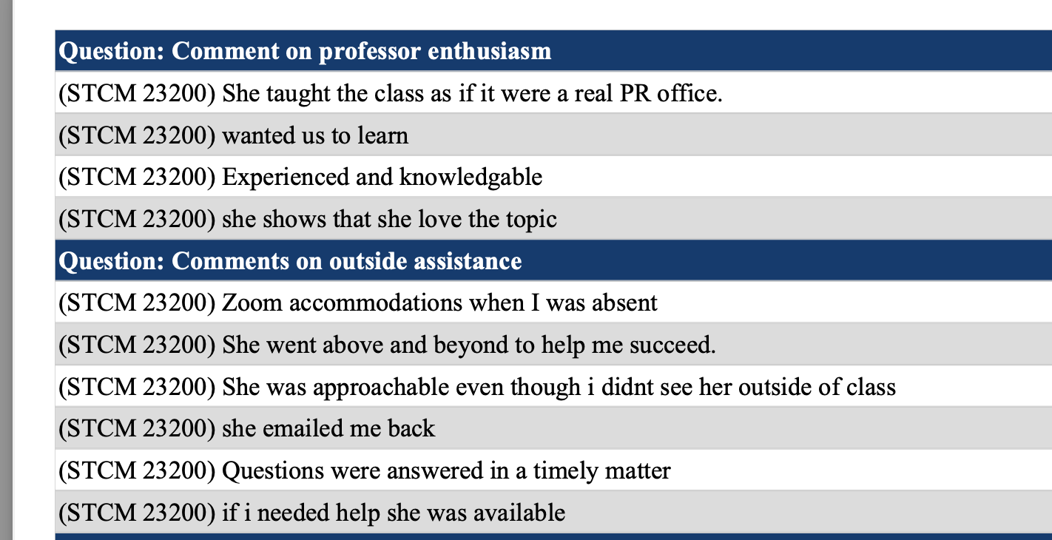

Slide 5
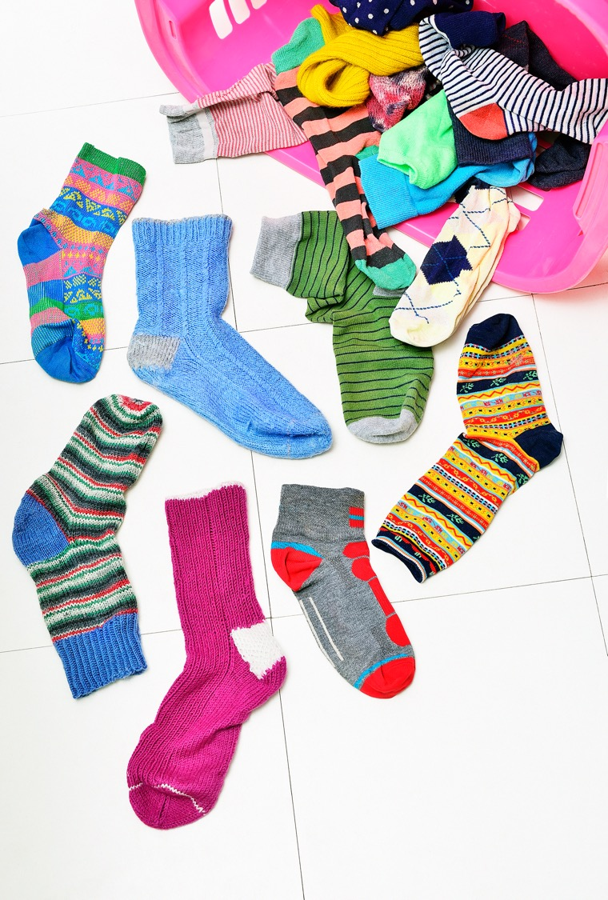
Rob was a great professor… his socks always matched his tie

Slide 7
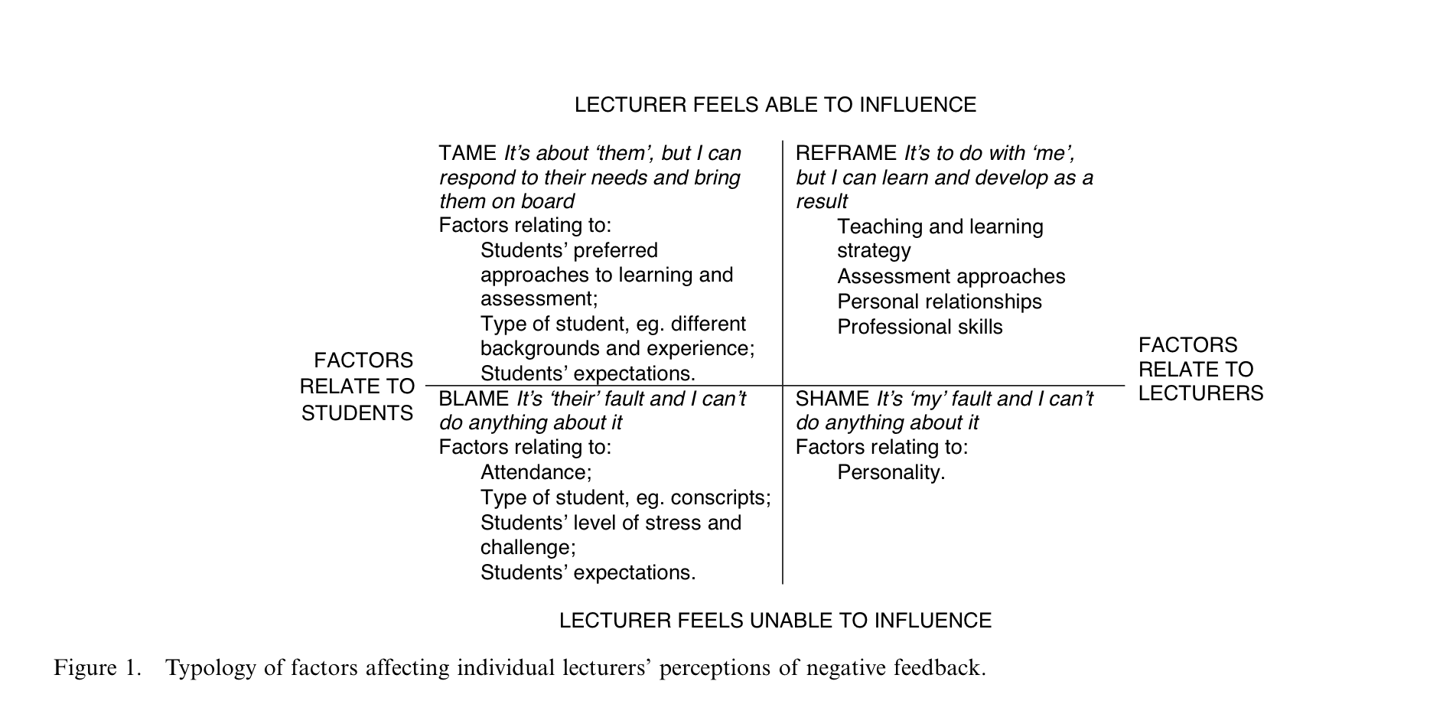
ARTHUR, L. From performativity to professionalism: lecturers’ responses to student feedback. Teaching in Higher Education, [s. l.], v. 14, n. 4, p. 441–454, 2009.

Slide 8
Contextual problems with “student evaluations”
student statements vs 'evaluations'
teaching eval or course eval?
do profs get to evaluate the class?
satisfaction vs learning- when can learners truly assess their experience?

Slide 9
What the research shows:
Student evals have very little correlation to what they’ve learned
Difficult courses are generally rated lower
Uttl, B, White, C, and Gonzalez, D. (2017).Meta-analysis of faculty's teaching effectiveness: Student evaluation of teaching ratings and student learning are not related, Studies in Educational Evaluation. (54) Pp 22-42.

Slide 10
Common complaints
Professor didn't explain the content clearly
Didn't stick to the syllabus
Grading wasn't fair / expectations weren't clear
Professor was unapproachable / unavailable / harsh
Classroom climate - professor behavior was problematic - micro-aggressions, unfair treatment
I didn't learn anything – it was boring

Slide 11
Some solutions
Professor didn't explain the content clearly
Spot quizzes and applications; explain what THEY need to do outside of class; identify content that doesn’t have one “correct” answer; try different modalities
Didn't stick to the syllabus
Explain why you are changing (more than once)
Grading wasn't fair / expectations weren't clear
Use rubrics; provide samples; have them evaluate some samples
Professor was unapproachable / unavailable / harsh
Articulate the climate you expect; comment on content not person, have 1:1 meetings
Professor behavior was problematic - micro-aggressions, unfair treatment
Collaboratively agree on norms and how to react if something goes wrong
I didn't learn anything – it was boring
Mix modalities every few minutes; Use pre-tests; relate class content to something they say they are interested in; Require self-reflection or resume statement reflecting accomplishments

Slide 12
Evidence-based concerns
Student evals are linked to gender, race and attractiveness – often decide in first few minutes if they like you & influenced by what they’ve heard about you
Students can be harsh to “get back” or justify their own failure
Student can be too lenient if they like the prof and feel they are being treated well
It’s easier for students to be satisfied with courses that teach them immediately-applicable and tangible skills
Selection bias in who responds and how
BUT: Most student evals (considered holistically) are not too far off base.
“The work also demonstrates that the highest volume, most derogatory, and most threatening abuse is directed towards women academics and those academics from marginalised groups”.
Heffernan, T. Abusive comments in student evaluations of courses and teaching: the attacks women and marginalised academics endure. High Educ (2022). https://doi.org/10.1007/s10734-022-00831-x
Profs at the top and bottom of evaluations have the lowest learning gains

Slide 13
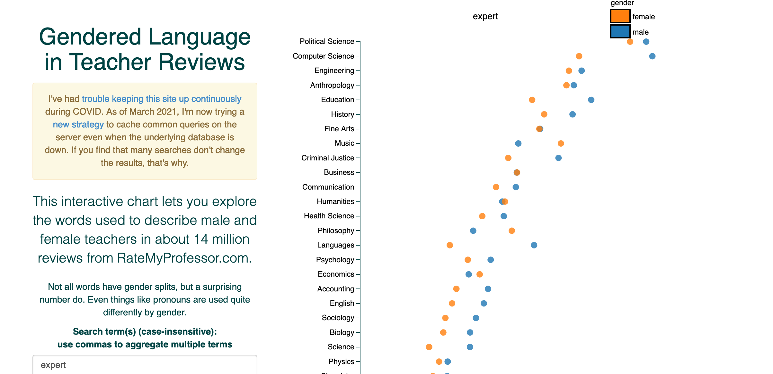
https://benschmidt.org/profGender/#

Slide 14
How do you respond to this?

Slide 15
How does this happen?
Taught 3 sections of the same course – similar composition of students
Sections 1 and 3 were very positive
Section 2 had many comments about the professor being harsh, unclear, unfair grader.

Slide 16
How administrators & committees think
It’s worrisome to have NO negative comments. We expect profs to challenge students
We expect an adjustment period
We don’t focus on the outliers or on times when we know there were challenges
Did you acknowledge and work on your problem areas?

Slide 17
How students think
Consider their most recent experiences – in h.s. they have had a LOT of structure
How does this prof make me feel?
Confused Confident. Overwhelmed. Ashamed. Entertained. Challenged Acknowledged. Helped. In control.
Am I going to get a good grade?
Can I predict how the course will go?
Does the prof like me?
Is this a safe space?
What do my peers say about the prof?

Slide 18
Can we make evals a mutual learning opportunity?
Students need to understand what’s done with their comments
They often evaluate you the way they feel you evaluated them
Can we make them less defensive?
Using AI and peer evals
Multiple check-in points for feedback

Slide 19
Why do students write such cruel comments?
Usually collected at end of the semester when they are most anxious
Anonymity – “deindividualization” loosens restraints. Often rate the way the think other students will rate – being “submerged in the group”
Instructor being out of the room limits empathy
Doing what’s moral – “saving” other students
Being upset at themselves for not learning – consumerism – did I get what I paid for?
LINDAHL, M.; UNGER, M. Cruelty in Student Teaching Evaluations. College Teaching, [s. l.], v. 58, n. 3, p. 71–76, 2010. DOI 10.1080/87567550903253643.

Slide 20
Don’t change YOU

